Slide 1
Image Recognition

Slide 2
Image recognition
Goal: Understand the challenges associated with image recognition and how to perform convolutions.
Program:
Challenges in image recognition
History of image recognition
Image recognition and neural networks
Convolutions (w/ practical session)
Convolutional Neural Network components

Slide 3
Challenges in image recognition

Slide 4
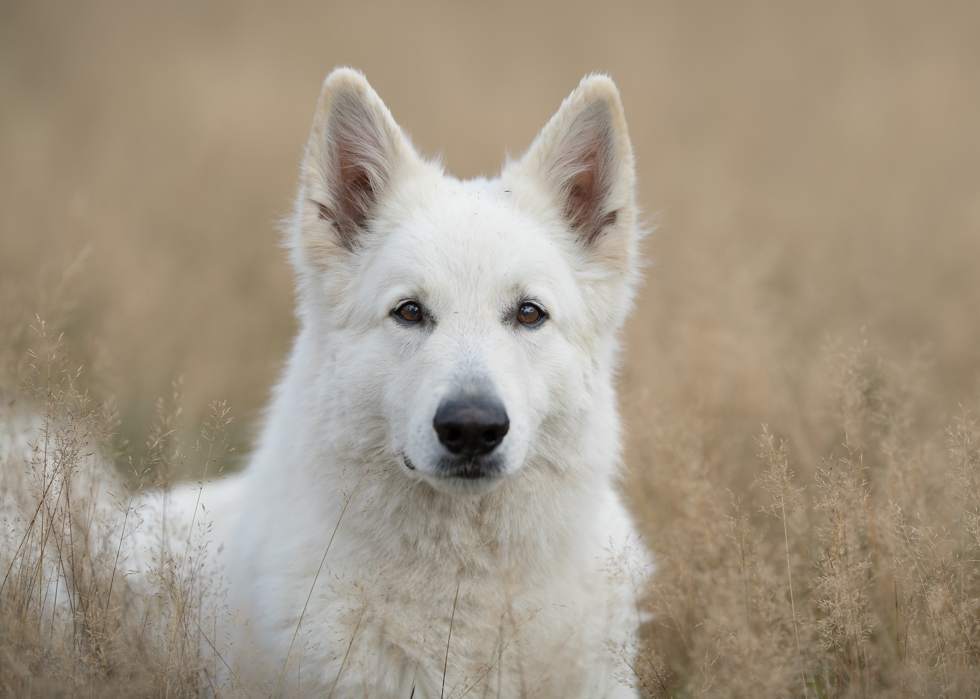
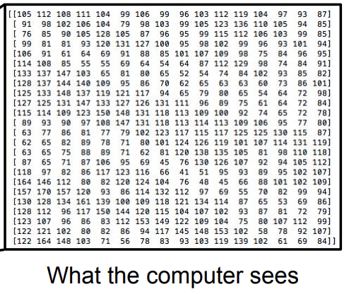
Semantic gap
An image is represented as a tensor of integers.
e.g. 800 x 300 x 3 (RGB)

Slide 5
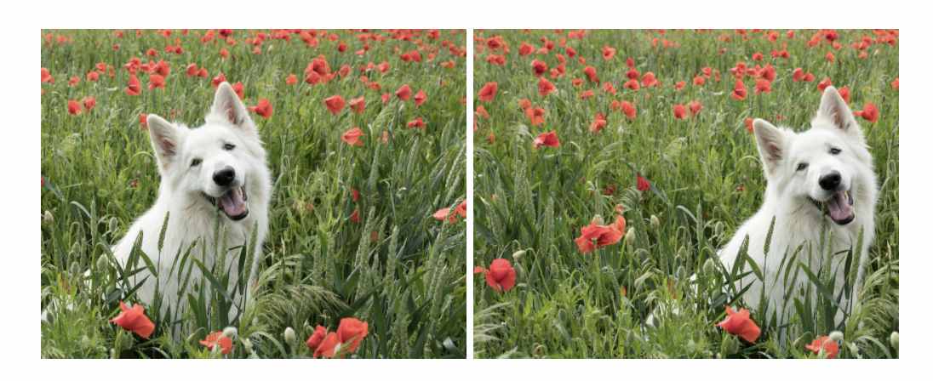
Challenges: viewpoint
All pixels change when the camera moves!

Slide 6
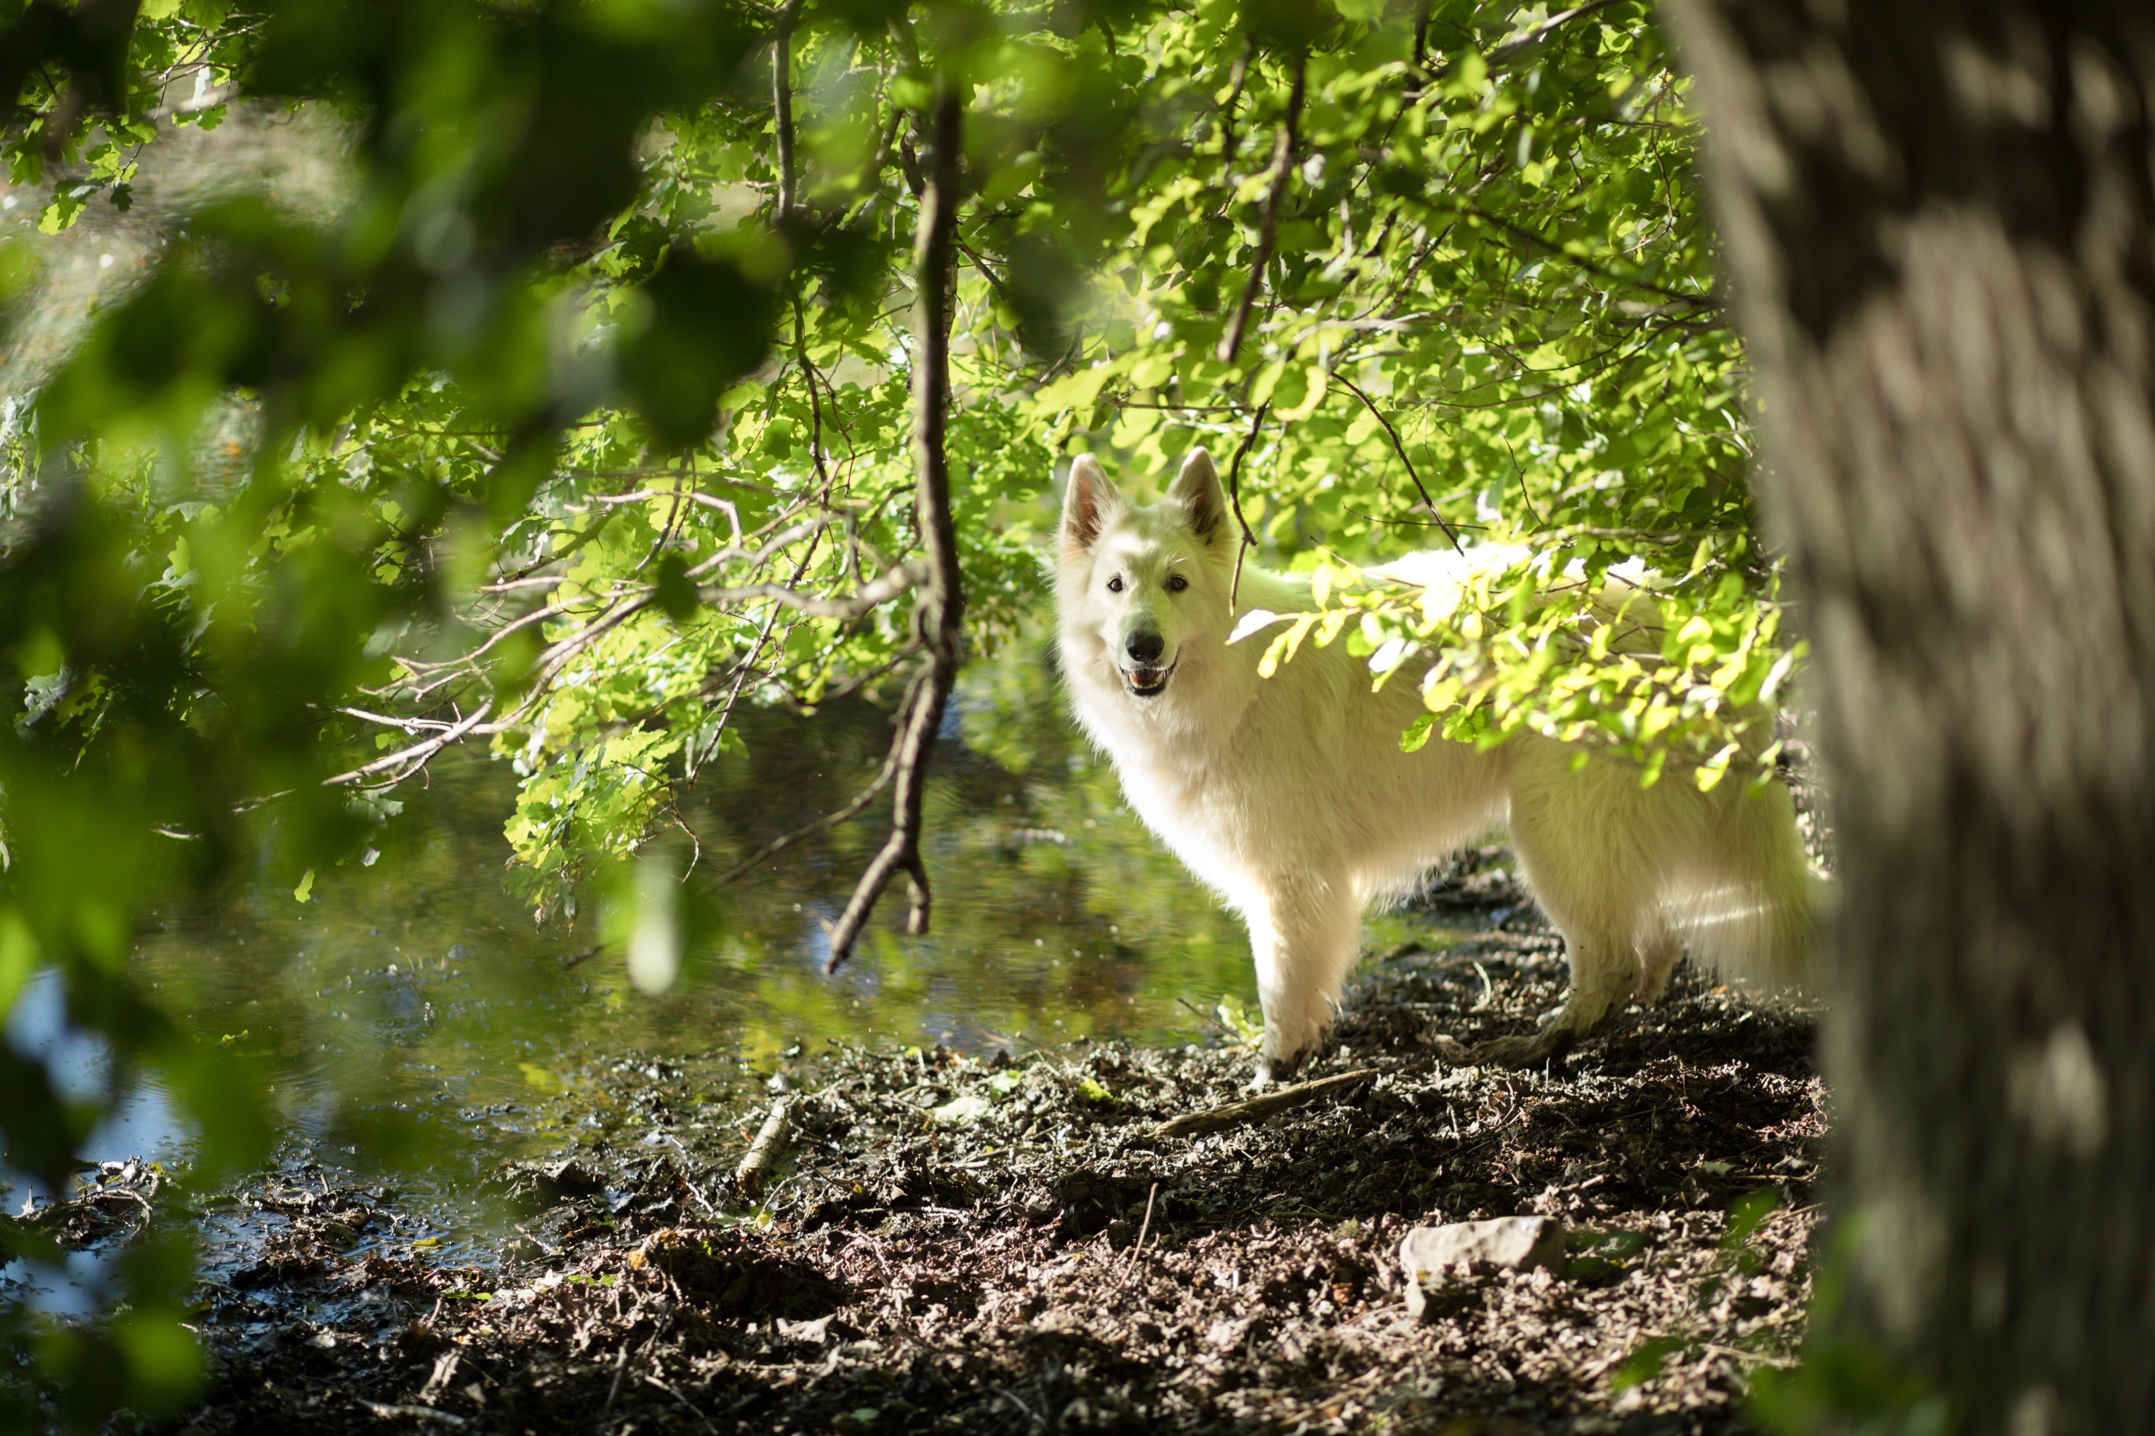
Challenges: background clutter
Background clutter can distract

Slide 7


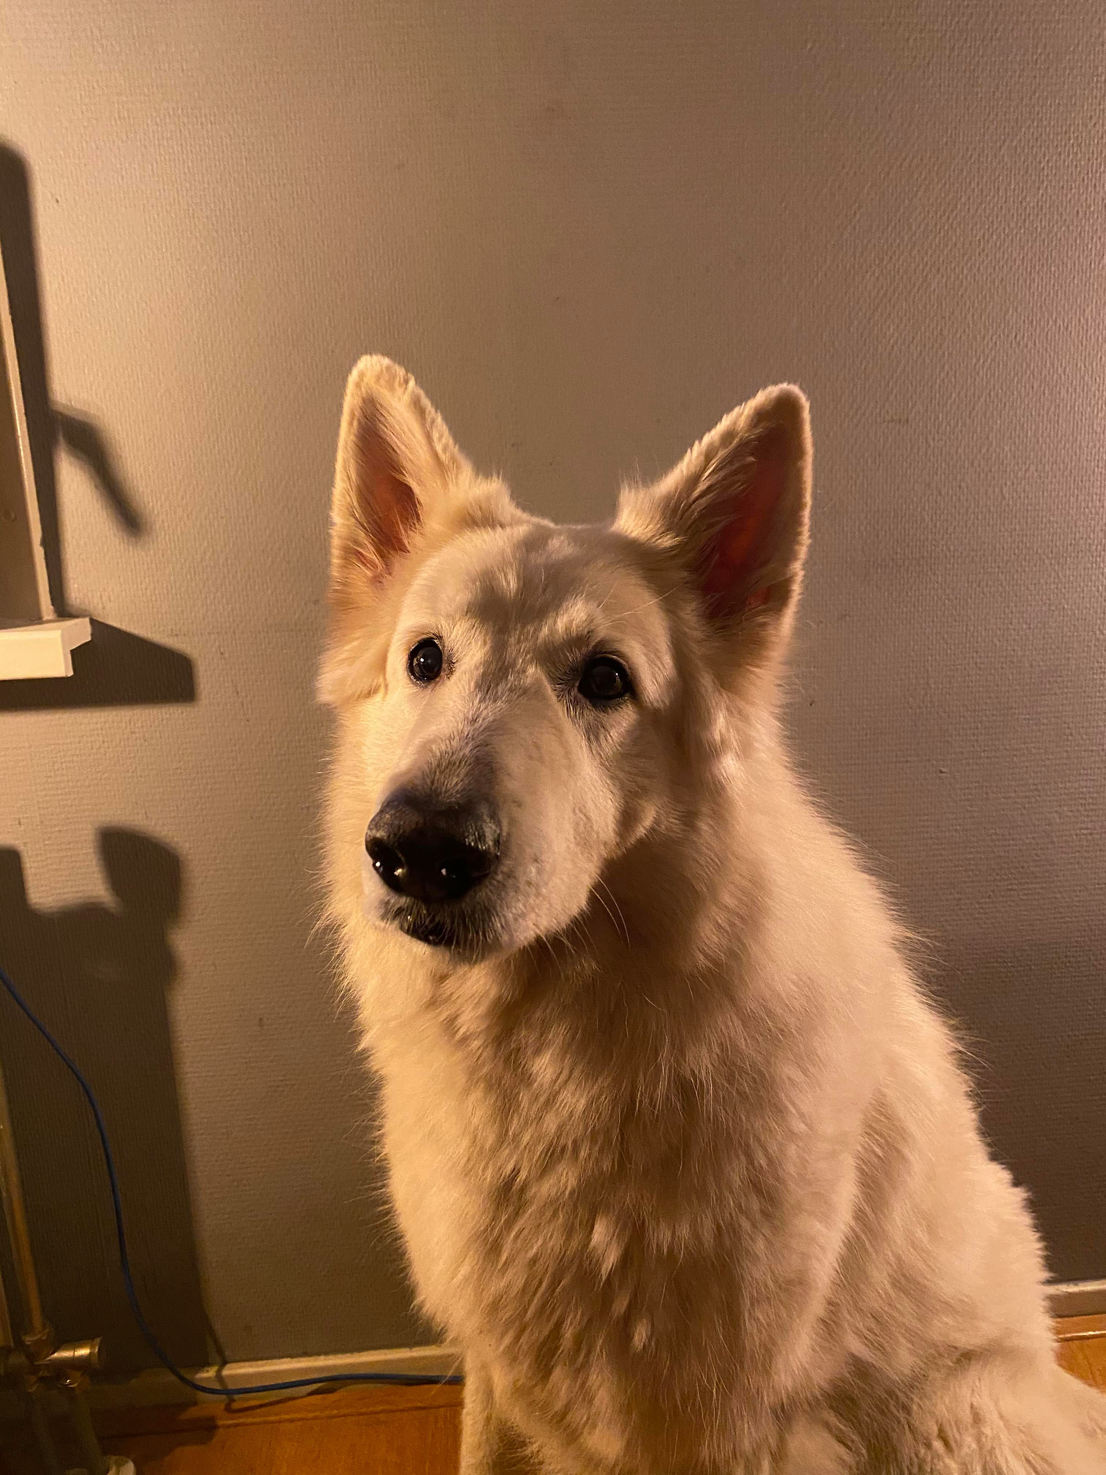
Challenges: Illumination
Illumination can distort the image.

Slide 8
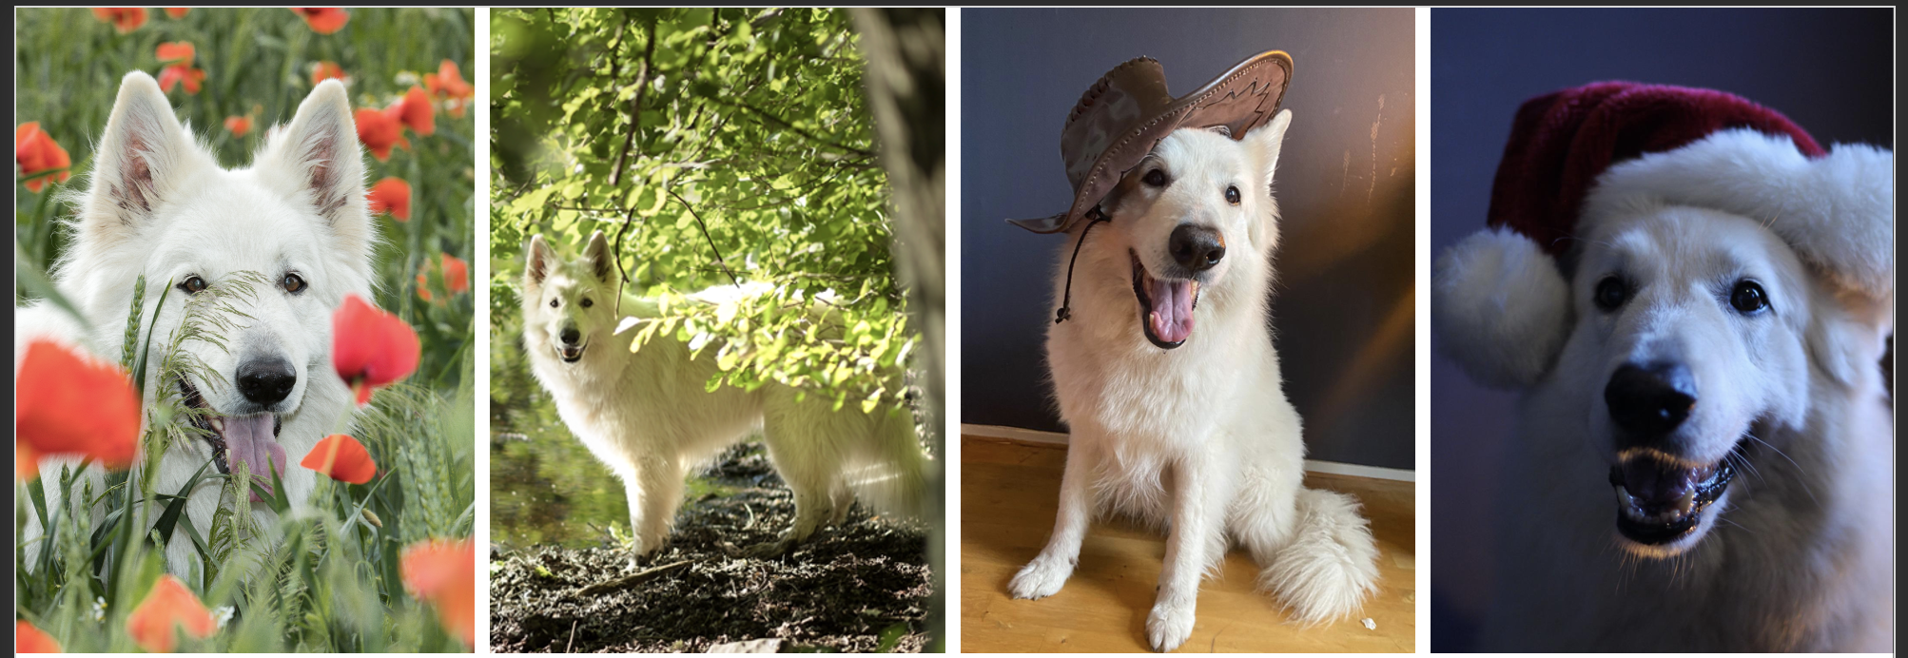
Challenges: Occlusion
Objects of interest can be partially occluded

Slide 9
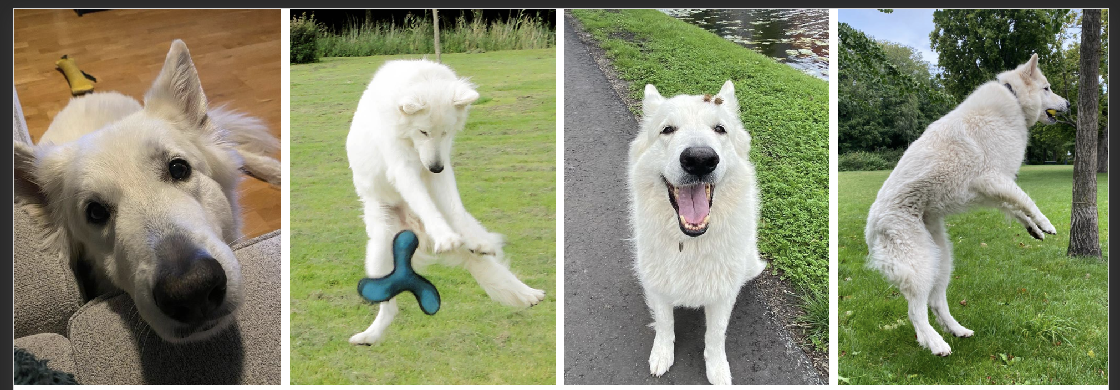
Challenges: Deformation
Objects of interest can be deformed

Slide 10

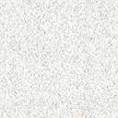
Challenges: Intraclass variation

Slide 11
History of image recognition

Slide 12
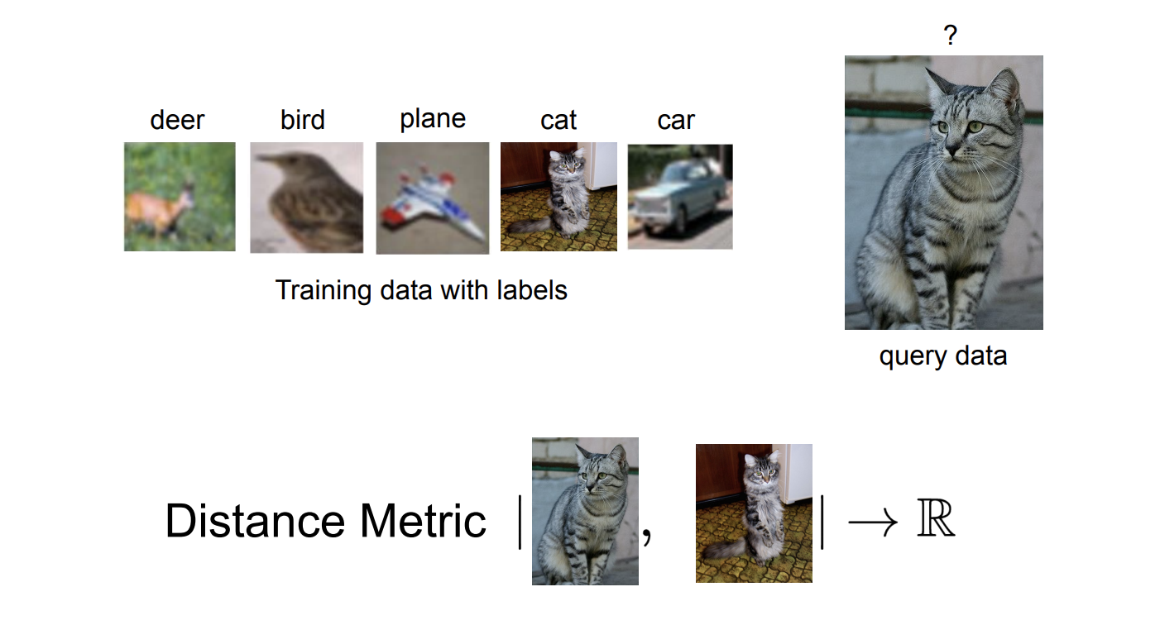
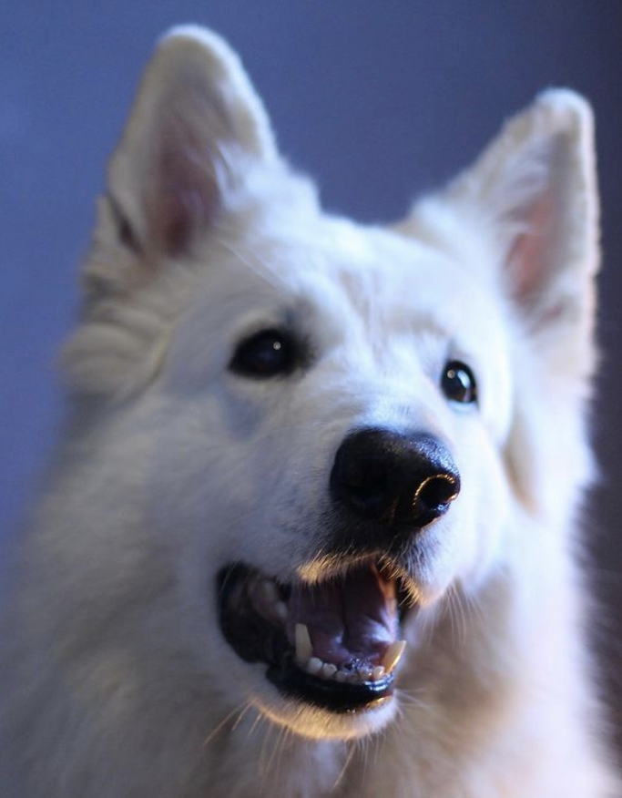
Approach: Nearest Neighbour

Slide 13
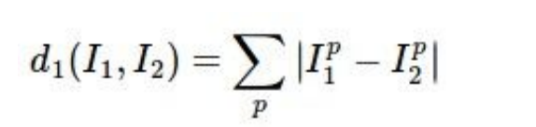
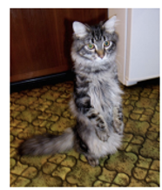
Approach: Nearest Neighbour
Distance metric to compare images, e.g.:
Image to classify
Image to in trainset
Pixel-wise differences
Distance
38 | 12 | 89 | 1
90 | 8 | 74 | 26
66 | 67 | 72 | 23
67 | 68 | 81 | 20
10 | 20 | 24 | 17
17 | 18 | 30 | 82
4 | 29 | 92 | 21
53 | 62 | 26 | 81
28 | 8 | 65 | 16
73 | 10 | 44 | 56
62 | 38 | 20 | 2
14 | 6 | 55 | 61
558

Slide 14
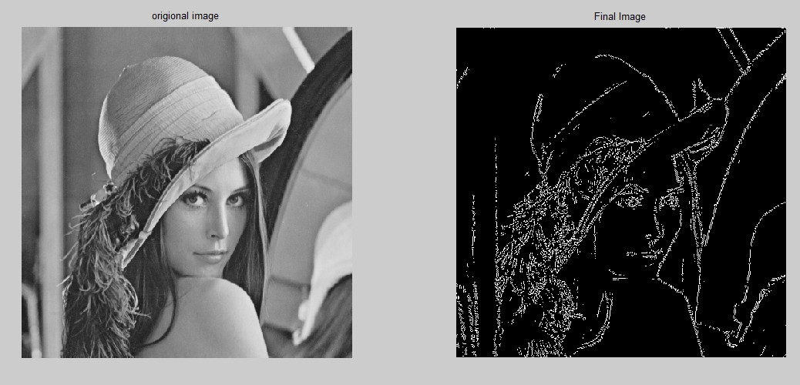
Approach: Feature Engineering
Edges and curves in images
Color histogram
Histogram of oriented gradients
E.g.
1 | 0 | 0 | … | 1 | 0 | 0
Notes:
https://learnopencv.com/edge-detection-using-opencv/
Convert image into tabular form then you can use traditional ML techniques
Loss of spatial information

Slide 15
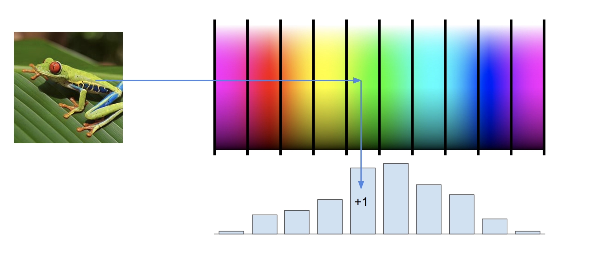
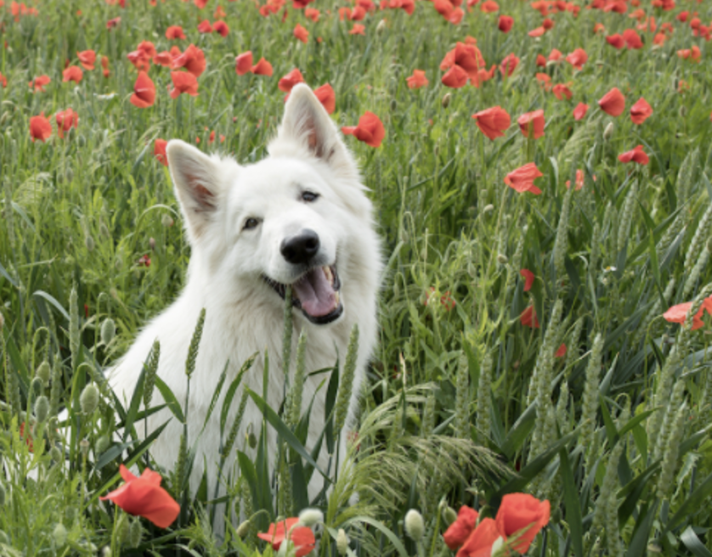
Approach: Feature Engineering
Edges and curves in images
Color histogram
Histogram of oriented gradients
Notes:
Compute a histogram for the image based on its colors
Loss of spatial information

Slide 16
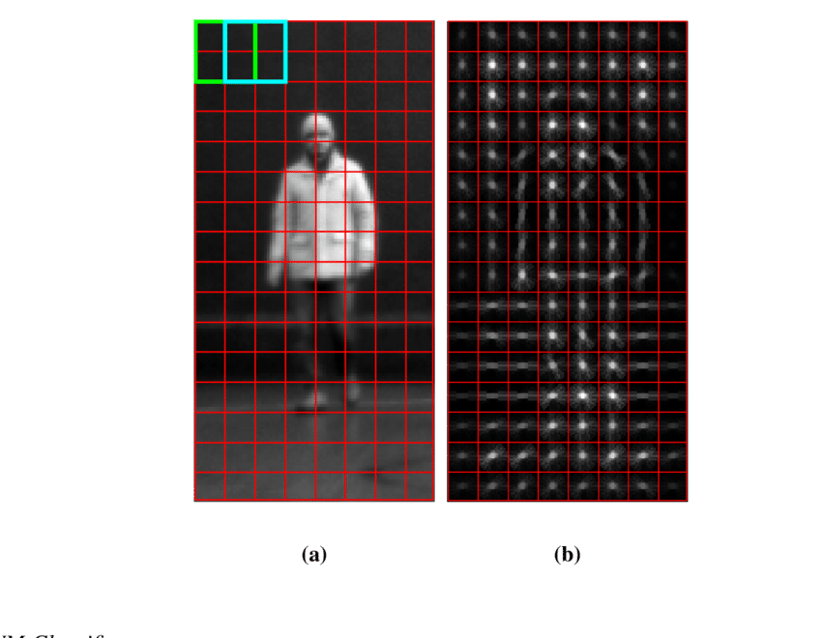
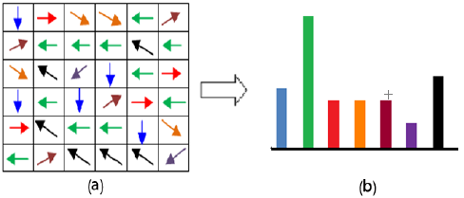
Approach: Feature Engineering
Edges and curves in images
Color histogram
Histogram of oriented gradients
Notes:
An oriented gradient consists of the strength and direction of the gradient.
Gradient magnitudes are collected into gradient angle bins to get a HOG
Compute HOG for 8x8 image patches
These can then be concatenated into the final feature vector
https://learnopencv.com/histogram-of-oriented-gradients/
Loss of spatial information

Slide 17
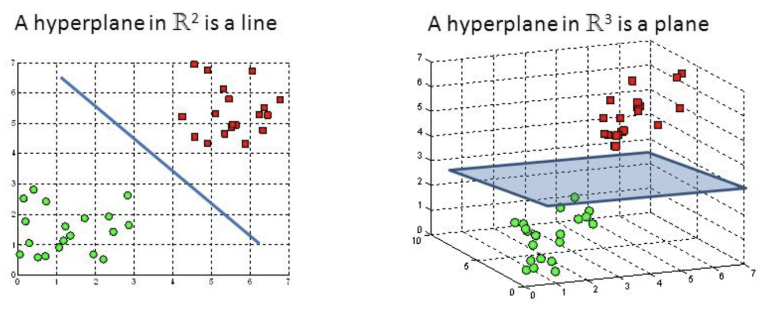
Classification
After extracting features from the image, we can then create a feature vector and train a classification algorithm, e.g. SVM.

Slide 18
Image recognition and neural networks

Slide 19
Deep Neural Network
Pros
No more feature engineering!
Cons
Curse of dimensionality
Loss of spatial information
Notes:
CoD – A huge amount of points are necessary in high dimensions to cover an input space.
32x32x3 → 64X64x3
Prior techniques covert image into vector so they lose spatial information.

Slide 20
The solution: convolutions

Slide 21
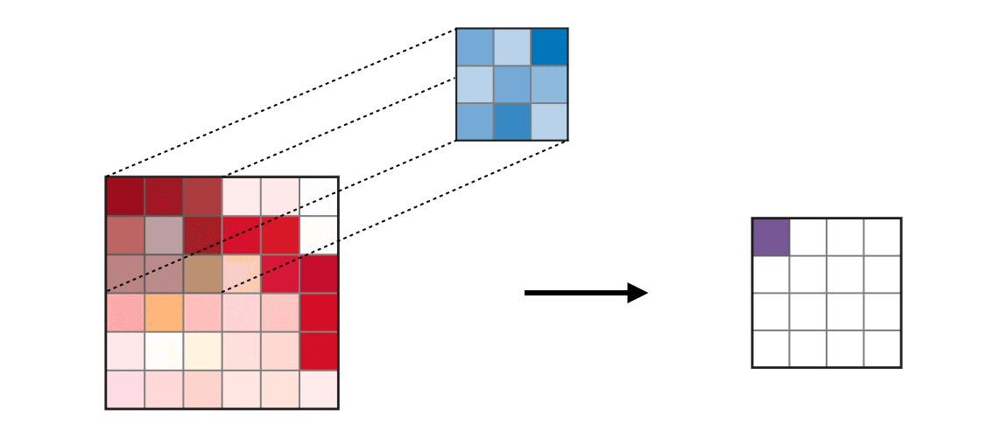
What is a convolution?
Convolution: operation on an input (e.g. image) that produces an output combing each pixel of an image with its local neighbours, weighted by a kernel.

Slide 22
What is a convlution?
Intuitively, it can be seen as calculating the dot product between image patch I and the reverse of filter K.
1 | 1 | 1 | 0 | 0
0 | 1 | 1 | 1 | 0
0 | 0 | 1 | 1 | 1
0 | 0 | 1 | 1 | 0
0 | 1 | 1 | 0 | 0
1 x1 | 1 x0 | 1 x0 | 0 | 0
0 x1 | 1 x1 | 1 x0 | 1 | 0
0 x1 | 0 x1 | 1 x1 | 1 | 1
0 | 0 | 1 | 1 | 0
0 | 1 | 1 | 0 | 0
1 | 1 | 1
0 | 1 | 1
0 | 0 | 1
3
Filter
Notes:
By looking at the definition of convolution, it is easy to see that convolution is equivalent to flipping the filter (kernel) in both dimensions (bottom to top, right to left) and applying cross-correlation.

Slide 23
What is a convlution?
Intuitively, it can be seen as calculating the dot product between image patch I and the reverse of filter K.
1 | 1 | 1 | 0 | 0
0 | 1 | 1 | 1 | 0
0 | 0 | 1 | 1 | 1
0 | 0 | 1 | 1 | 0
0 | 1 | 1 | 0 | 0
1 | 1 x1 | 1 x0 | 0 x0 | 0
0 | 1 x1 | 1 x1 | 1 x0 | 0
0 | 0 x1 | 1 x1 | 1 x1 | 1
0 | 0 | 1 | 1 | 0
0 | 1 | 1 | 0 | 0
1 | 1 | 1
0 | 1 | 1
0 | 0 | 1
3 | 5
Filter
In practice the convolutions are not flipped!
(So we are actually performing cross-correlation!)
Notes:
By looking at the definition of convolution, it is easy to see that convolution is equivalent to flipping the filter (kernel) in both dimensions (bottom to top, right to left) and applying cross-correlation.

Slide 24
What is a cross-correlation?
Intuitively, it can be seen as calculating the dot product between image patch I and the filter K.
1 | 1 | 1 | 0 | 0
0 | 1 | 1 | 1 | 0
0 | 0 | 1 | 1 | 1
0 | 0 | 1 | 1 | 0
0 | 1 | 1 | 0 | 0
1 x1 | 1 x1 | 1 x1 | 0 | 0
0 x0 | 1 x1 | 1 x1 | 1 | 0
0 x0 | 0 x0 | 1 x1 | 1 | 1
0 | 0 | 1 | 1 | 0
0 | 1 | 1 | 0 | 0
1 | 1 | 1
0 | 1 | 1
0 | 0 | 1
6
Filter
Notes:
By looking at the definition of convolution, it is easy to see that convolution is equivalent to flipping the filter (kernel) in both dimensions (bottom to top, right to left) and applying cross-correlation.

Slide 25
What is a cross-correalation?
Intuitively, it can be seen as calculating the dot product between image patch I and the reverse of filter K.
1 | 1 | 1 | 0 | 0
0 | 1 | 1 | 1 | 0
0 | 0 | 1 | 1 | 1
0 | 0 | 1 | 1 | 0
0 | 1 | 1 | 0 | 0
1 | 1 x1 | 1 x1 | 0 x1 | 0
0 | 1 x0 | 1 x1 | 1 x1 | 0
0 | 0 x0 | 1 x0 | 1 x1 | 1
0 | 0 | 1 | 1 | 0
0 | 1 | 1 | 0 | 0
1 | 1 | 1
0 | 1 | 1
0 | 0 | 1
6 | 5
Filter
Notes:
By looking at the definition of convolution, it is easy to see that convolution is equivalent to flipping the filter (kernel) in both dimensions (bottom to top, right to left) and applying cross-correlation.

Slide 26

Symmetric filter
If the filter is symmetric than the output will be the same for a convolution and cross-correlation.
1 | 0 | 1
0 | 1 | 0
1 | 0 | 1
Filter

Slide 27
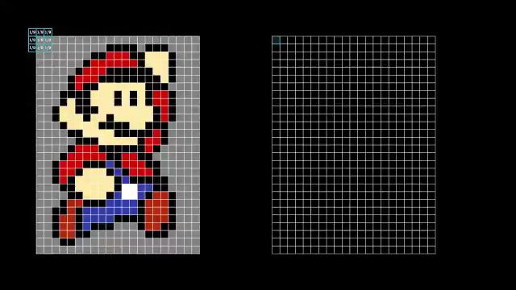
What is a convolution?
02-02-convolutions
notebook

Slide 28
Convolutional Neural Network components

Slide 29

Convolutional layer
Learnable filters
Filters are used to create feature maps
Notes:
i.e. a feature map is the output from using the filter on the image
Different filters will produce different feautre maps
We often use multiple filters to extract different feature maps from a single input

Slide 30

Convolutional layer
An activation function is then applied to the feature maps
Notes:
Af

Slide 31
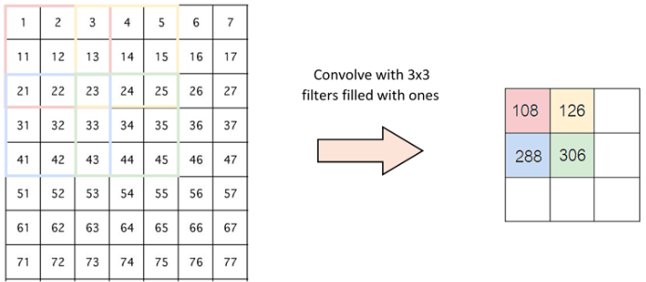
Spatial reduction
Stride
Notes:
Stride is the number of pixels shifts over the input matrix. When the stride is 1 then we move the filters to 1 pixel at a time. When the stride is 2 then we move the filters to 2 pixels at a time and so on

Slide 32
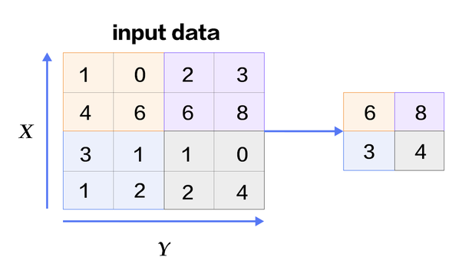
Spatial reduction
Pooling
Notes:
Spatial pooling reduces the dimensionality of each map but retains important information. Spatial pooling can be of different types:
Max Pooling
Average Pooling
Sum Pooling
e.g. max pooling takes the largest element from the rectified feature map.

Slide 33
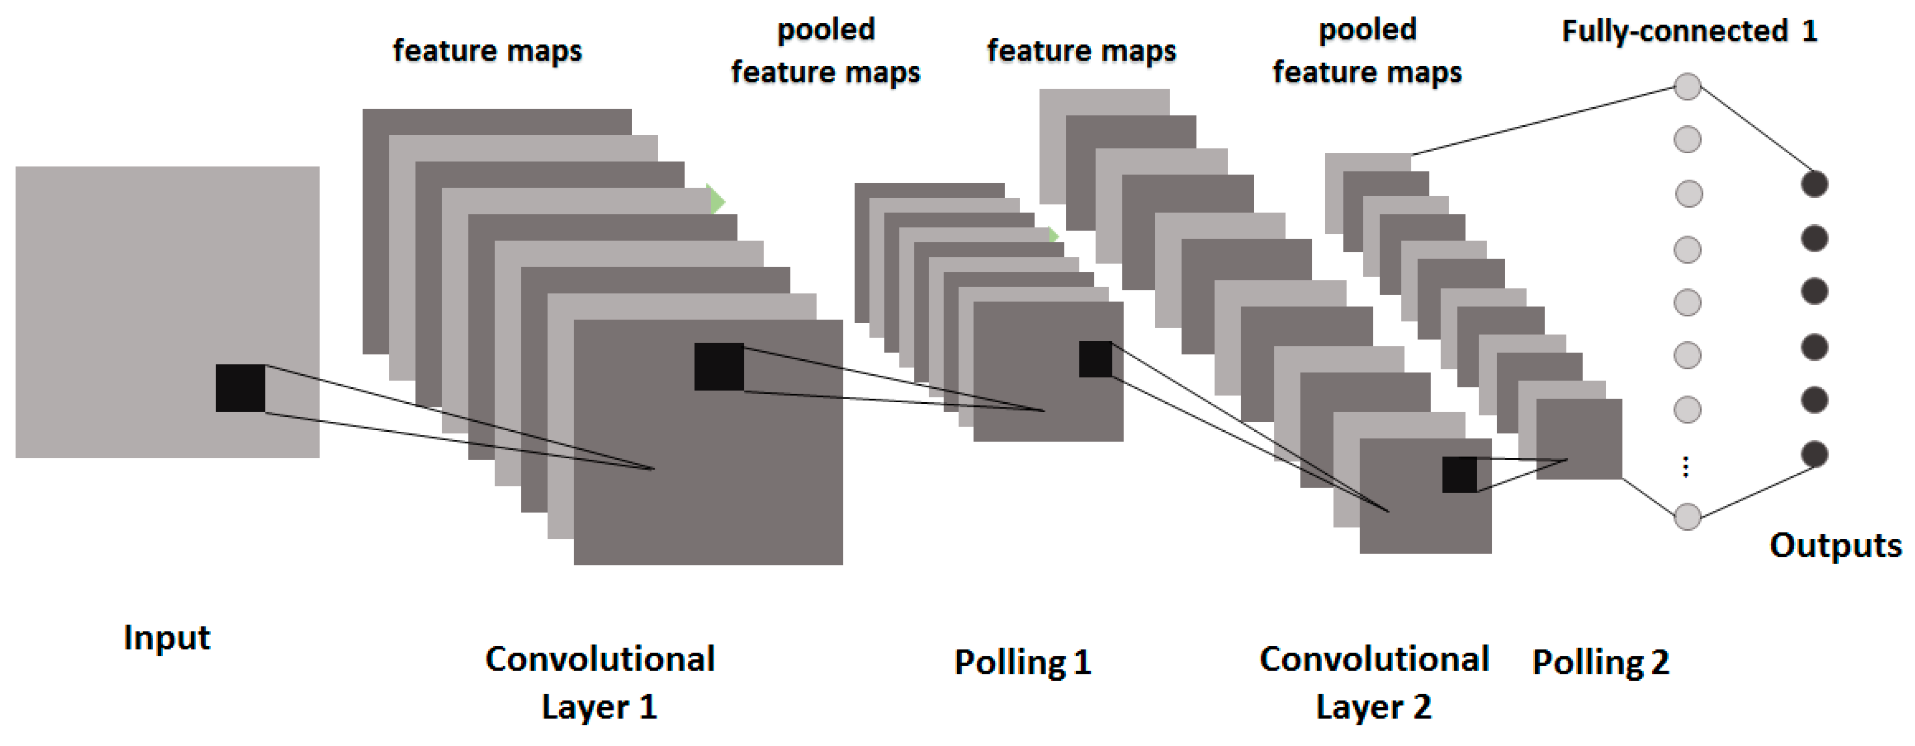
Convolutional Neural Network
Notes:
Different filters will produce different feautre maps
Notice how the final pooled feature maps are mapped to a fully connected layer.
Alternatively we could use global average pooling.

Slide 34
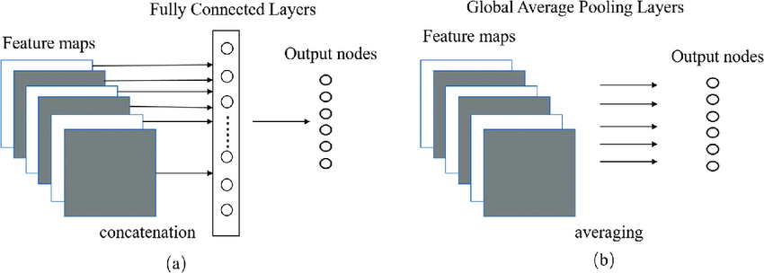
Global average pooling

Slide 35
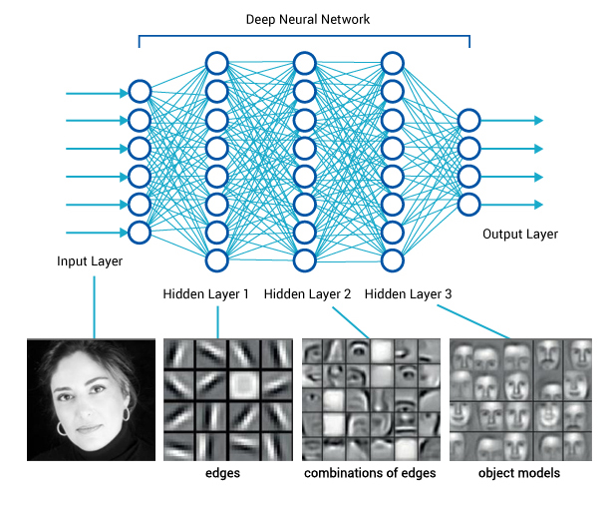
Convolutional neural network
Notes:
In the first layer the network can detect edges and their orientation, in the next layer it can detect a specific combination of edges (like a curved shape), and at higher levels even more complicated shapes, each layer building on the patterns that were detected on the layer below.

Slide 36
Typical CNN
Convolution with ReLU activation
Pooling or stride to reduce dimensionality
Fully-connected layer at the end
Bonus:
Batch Normalization and Dropout
Extra fully-connected layer at the end

Slide 37
Summary

Slide 38
Image recognition
In this section we have covered
Challenges in image recognition
History of image recognition
Image recognition and neural networks
Convolutions (w/ practical session)
Convolutional Neural Network components
In the next exercise we will build a CNN with Keras

Slide 39
Keras CNN

Slide 40
Convolutional Neural Network
Let’s look at an example.
02-01-keras_cnn
exercise

Slide 41
Questions?

